Slide 1

PREDICTION FOR UNIVERSITY ADMISSION USING MACHINE LEARNING
Presented by:
Team no: CSE-002
18UK1A0505- BAJJURI ANUHYA
18UK1A0556- BOURISHETTY SWETHA
18UK1A0560- VIJAYAGIRI SAIHARSHA
18UK1A0523- JUNNUTHULA AKSHAYA

Slide 2
OUTLINE
INTRODUCTION
OBJECTIVE
DATA
MACHINE LEARNING APPROACHES
VISUALIZATION OF GRAPHS
SOFTWARE REQUIREMENTS
CONCLUSION

Slide 3
INTRODUCTION
Specific preparation plays a crucial part in your life. Thus education preparation students often have multiple questions about universities which they can get admission and scholarship and accommodation. One of the main concerns is getting admitted to their dream university .It's seen that students still choose to obtain their education from universities that are known internationally.
when it comes to international graduates, the United States of America is the first preference of the majority of students.
With most world-renowned colleges, Wide variety of courses available in each discipline, highly accredited education and teaching programs, student scholarships, are available for international students.
The number of people pursuing higher studies in different countries are rapidly increasing. The background reason for the students going to abroad universities for Masters is the no. of job opportunities present are low and number of people for those jobs are very high in their respective countries . This inspires many students in their profession to pursue postgraduate studies.
It is seen that there is quite a large number of students from universities in the USA pursuing Masters in the field of computer science, the emphasis of this research will be on these students.
Many colleges in the U.S. follow similar requirements for student admission. Colleges take different factors into account, such as the ranking on aptitude assessment and academic record review. The command over the English language is calculated on the basis of their performance in the English skills test, such as TOEFL and IELTS. The admission committee of universities takes the decision to approve or reject a specific candidate on the basis of the overall profile of the applicant application.

Slide 4
OBJECTIVE:
400 applicants have been surveyed as potential students for UCLA. The university weighs certain aspects of a student’s education to determine their acceptance.
The objective is to explore what kind of data is provided, determine the most important factors that contribute to a student’s chance of admission and select the most accurate model to predict the probability of admission.
So our goal is to develop a model which will tell the students their chance of admission into a respective university. This model will consider all the crucial factors which plays a vital role in student admission process and should have high accuracy.

Slide 5
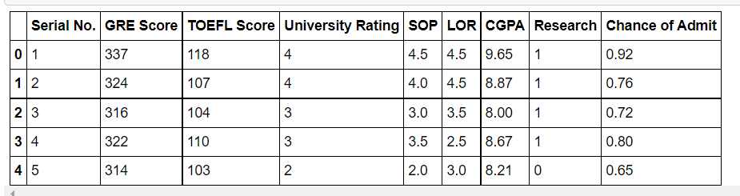
DATA:
University Dataset for determining university decision
401 rows with 9 columns
GRE score,
TOEFL score,
University rating,
SOP,
LOR,
CGPA,
Research,
Chance of admit.
Data source: Internet

Slide 6
DATA VISUALISATION:
Data visualization is where a given dataset is presented in a graphical format. It helps the detection of patterns, trends and correlations that might go undetected in text-based data. Understanding your data and the relationship present within it is just as important as any algorithm used to train your machine learning model. Machine learning models will perform poorly on data that wasn’t visualized and understood properly.
To visualize the dataset we need libraries called Matplotlib and Seaborn. The Matplotlib library is a Python 2D plotting library that allows you to generate plots, scatter plots, histograms, bar charts etc.

Slide 7
MODEL BUILDING:
There are several Machine learning algorithms to be used depending on the data you are going to process such as images, sound, text, and numerical values. The algorithms that you can choose according to the objective that you might have it may be Classification algorithms are Regression algorithms.
Example:
1.Linear Regression
2.Logistic Regression
3. Random Forest Regression / Classification.
4. Decision Tree Regression / Classification.
You will need to train the datasets to run smoothly and see an incremental improvement in the prediction rate.
On our Dataset , we have applied Logistic ,Multilinear Regression and Random Forest to predict the Accuracy.

Slide 8
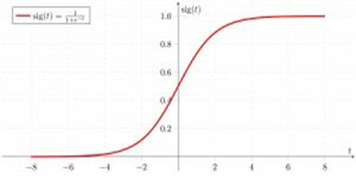
Multiple Linear Regression
MACHINE LEARNING ALGORITHMS:
Multiple Linear Regression is one of the important regression algorithms which models the linear relationship between a single dependent continuous variable and more than one independent variable.
Random Forest
A random forest is a machine learning technique that’s used to solve regression and classification problems. It utilizes ensemble learning, which is a technique that combines many classifiers to provide solutions to complex problems.
Working of Random Forest Algorithm
Step 1 − First, start with the selection of random samples from a given dataset.
Step 2 − Next, this algorithm will construct a decision tree for every sample. Then it will get the prediction result...
Step 3 − In this step, voting will be performed for every predicted result.
Step 4 − At last, select the most voted prediction result as the final prediction result.

Slide 9
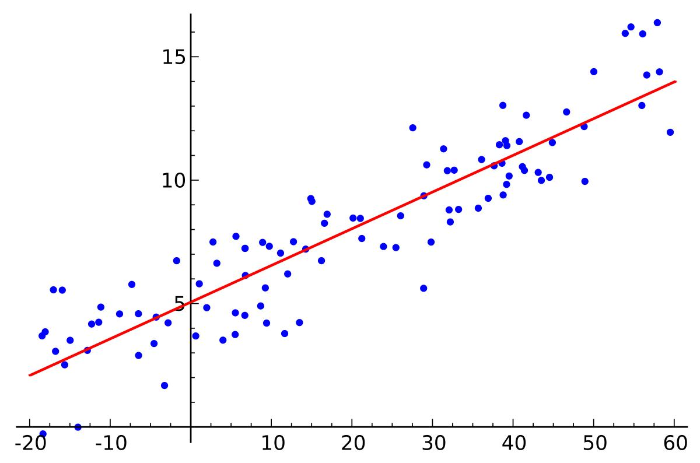
LOGISTIC REGRESSION:
Logistic regression is a supervised learning classification algorithm used to predict the probability of a target variable. The nature of target or dependent variable is dichotomous, which means there would be only two possible classes. ... Mathematically, a logistic regression model predicts P(Y=1) as a function of X.
Logistic Regression is used when the dependent variable (target) is categorical. For example,
To predict whether an email is a spam (1) or (0)
Whether the tumor is malignant (1) or not (0)
Out of all the algorithms Logistic Regression got the highest accuracy .
So, We build a model with Logistic regression.

Slide 10
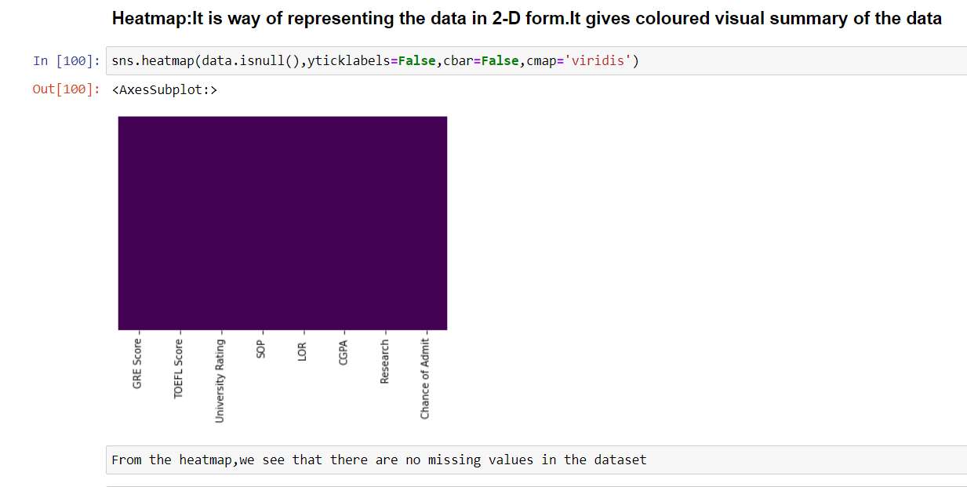
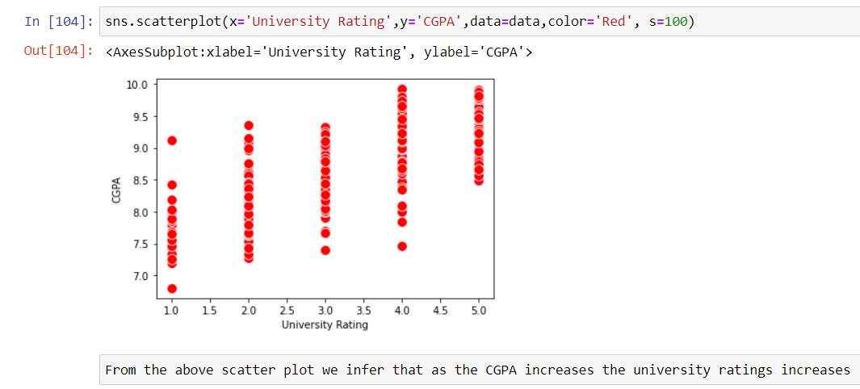
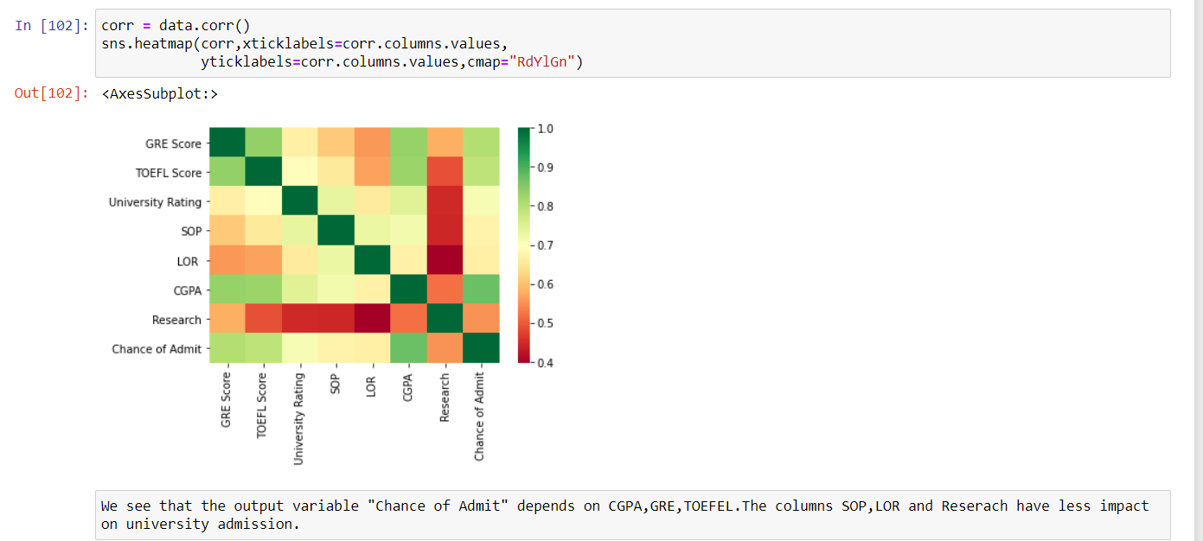
VISUALISATION OF GRAPHS:

Slide 11
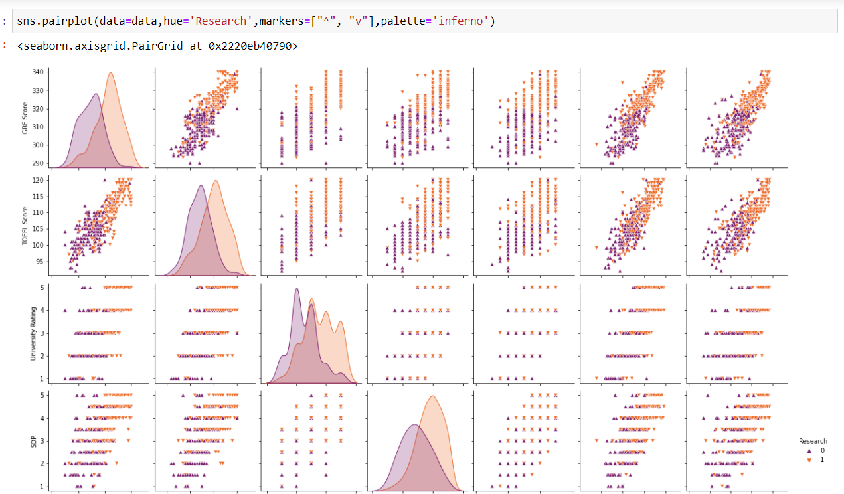
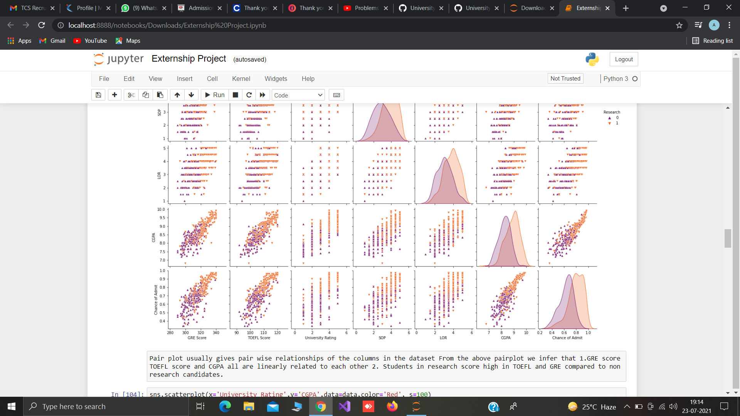
Pair plot usually gives pair wise relationships of the columns in the dataset From the above pair plot we infer that 1.GRE score TOEFL score and CGPA all are linearly related to each other 2. Students in research score high in TOEFL and GRE compared to non research candidates.

Slide 12
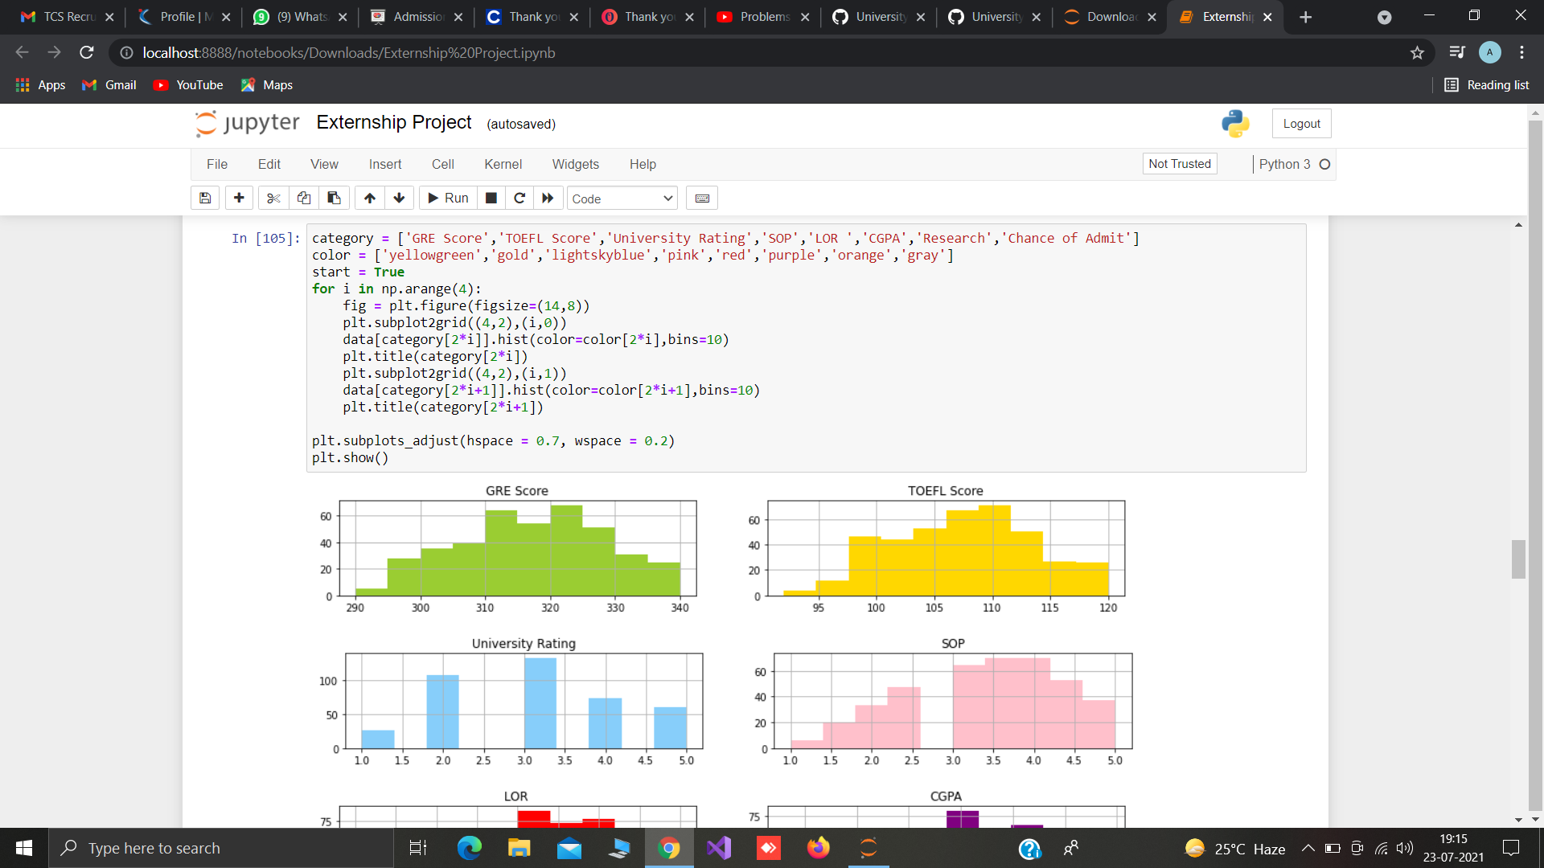
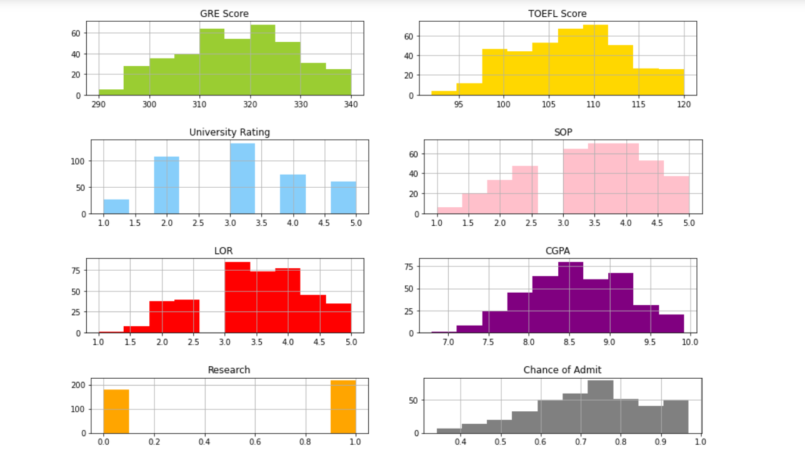

Slide 13
SOFTWARE REQUIREMENTS:
Google colab
Anaconda navigator
Jupyter notebook
Machine learning tools: pandas,
numpy,
matplotlib,
scikitlearn,
seaborn

Slide 14
CONCLUSION:
In this project we have presented the prediction for university admission
Prediction using machine learning
For the better results we used logistics regression algorithm and proved with 90% accuracy

